Slide 1
Web Programming
MongoDB - Mongoose
Lecture 21
Notes:
.

Slide 2
Intro to MongoDB
MongoDB is a NoSQL, document-oriented database.
Think of MongoDB like a giant online cupboard where you store your app’s information — like users, posts, comments — but instead of folders and files, you use collections and documents.
It stores data in a flexible format (like JSON).
You don't have to define all the fields beforehand like you do in SQL (MySQL/PostgreSQL).

Slide 3
Example
{
"_id": "123",
"name": "Ali",
"age": 25,
"skills": ["JavaScript", "Node.js"]
}

Slide 4
Mongoose
Mongoose is like a translator between your JavaScript code and the MongoDB database.
Helps you define rules for your data (like "age must be a number").
Makes it easier to connect, save, and fetch data.
You define "blueprints" for your data using something called a Schema.

Slide 5
Install MongoDB
Go to the official MongoDB site and download MongoDB.
Install Compass, which is a GUI to see your data like an app — no coding needed.
With Compass:
You can see collections, add documents, and search easily.
Great for beginners!

Slide 6
Connecting to MongoDB with Mongoose
First, install Mongoose:
npm install mongoose
Then in your JavaScript file:
const mongoose = require('mongoose');
mongoose.connect('mongodb://localhost:27017/myapp')
.then(() => console.log("Connected!"))
.catch(err => console.log("Error", err));
You are now ready to read/write data to your MongoDB!
localhost:27017 = MongoDB address
myapp = database name

Slide 7
Schema in Mongoose
A schema is like a blueprint of your data. You tell Mongoose: “Hey, every user must have a name (as a string), and an age (as a number).”
Example:
const userSchema = new mongoose.Schema({
name: String,
age: Number
});
This means:
name should be text
age should be a number

Slide 8
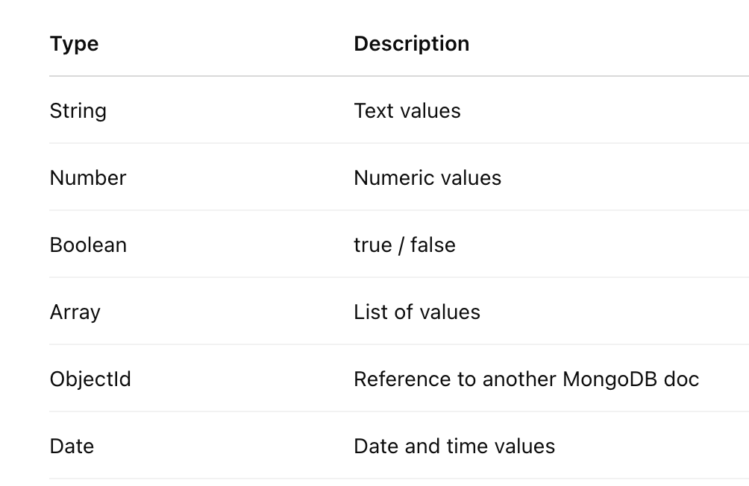
MongoDB DataType
Here are the most common types of data you'll use:

Slide 9
Validation
required: true → Field must be filled
min: 18 → Minimum value maxLength: 50 → Max characters
match: /pattern/ → Match a regex pattern
const userSchema = new mongoose.Schema({
name: { type: String, required: true },
email: { type: String, match: /@/, required: true },
age: { type: Number, min: 18 },
isActive: { type: Boolean, default: true }
});

Slide 10
User Schema
const userSchema = new mongoose.Schema({
name: {type: String, required: true, minLength: 3},
email: {type: String, match: /.+\@.+\..+/, required: true},
age: {type: Number, min: 18,max: 60},
isActive: {type: Boolean,default: true}
});

Slide 11
min & minLength
min: It sets the minimum value a number field is allowed to have.
minLength: It sets the minimum number of characters in a string.
const userSchema = new mongoose.Schema({
age: { type: Number, min: 18 }
name: { type: String, minLength: 3 }
});
This means age must be at least 18.
This means name must be at least 3 characters long.

Slide 12
Timestamp
Mongoose can automatically track when your data is created and updated.
const postSchema = new mongoose.Schema({
title: String,
content: String
}, { timestamps: true });
You’ll now get:
createdAt: When the document was made
updatedAt: When it was last changed

Slide 13
Defaults
In Mongoose, you can set default values for fields when documents are created. This is useful when certain fields should always have a value if not provided by the user.
const userSchema = new mongoose.Schema({
name: { type: String, required: true },
age: { type: Number, default: 18 },
isActive: { type: Boolean, default: true }
});
age will default to 18 if no value is provided.
isActive will default to true if not specified.
Timestamps: Automatically set the createdAt and updatedAt dates

Slide 14
Relations
MongoDB is a NoSQL database, so it's document-based, not table-based. But we still need to connect data across collections, like:
A User has many Posts
A Post has many Comments
A Product has many Reviews
These connections are called relationships between documents

Slide 15
1-to-1 Relationship (User ↔ Profile)
const userSchema = new mongoose.Schema({
name: { type: String, required: true },
email: { type: String, required: true, unique: true },
profile: { type: mongoose.Schema.Types.ObjectId, ref: 'Profile' } // Reference to Profile (optional)
});
const profileSchema = new mongoose.Schema({
bio: { type: String },
location: { type: String },
user: { type: mongoose.Schema.Types.ObjectId, ref: 'User' } // Reference to User (inverse reference)
});

Slide 16
User:
{
"_id": ObjectId("661191abcde1234567890001"),
"name": "John Doe",
"email": "john@example.com",
}
Profile:
{
"_id": ObjectId("661191fghij1234567890002"),
"bio": "Full-stack developer and tech enthusiast.",
"location": "San Francisco",
"user": ObjectId("661191abcde1234567890001")
}

Slide 17
1 to Many (User ↔ Posts)
const userSchema = new mongoose.Schema({
name: { type: String, required: true },
email: { type: String, required: true, unique: true }
});
const postSchema = new mongoose.Schema({
title: { type: String, required: true },
content: { type: String, required: true },
userId: { type: mongoose.Schema.Types.ObjectId, ref: 'User' } // Reference to User
});

Slide 18
User:
{
"_id": ObjectId("66118f84d2e4f32ff7a12345"),
"name": "Alice",
"email": "alice@example.com"
}
Post:
{
"_id": ObjectId("66119021d2e4f32ff7a67890"),
"title": "My First Blog",
"content": "This is my very first blog post using Mongoose!",
"userId": ObjectId("66118f84d2e4f32ff7a12345") // Points to Alice
}

Slide 19
Many to Many (Students ↔ Courses)
const studentSchema = new mongoose.Schema({
name: { type: String, required: true },
courses: [{ type: mongoose.Schema.Types.ObjectId, ref: 'Course' }] // Reference to Course (array)
});
const courseSchema = new mongoose.Schema({
title: { type: String, required: true },
students: [{ type: mongoose.Schema.Types.ObjectId, ref: 'Student' }] // Reference to Student (array)
});

Slide 20
Student:
{
"_id": ObjectId("studentId123"),
"name": "Alice",
"email": "alice@example.com",
"courses": [
ObjectId("courseId456"), // Refers to “Programming"
ObjectId("courseId789") // Refers to "Development"
]
}
Courses:
{
"_id": ObjectId("courseId456"),
"title": "Programming",
"description": "A basic course on programming concepts",
"students": [
ObjectId("studentId123")// Refers to Alice
]
}
{
"_id": ObjectId("courseId789"),
"title": "Development",
"description": "An advanced course on building web applications",
"students": [
ObjectId("studentId123") // Refers to Alice
]
}

Slide 21
Resources
MongoDB (General)
1. MongoDB University (Official & Free!)
Website: university.mongodb.com
Courses:
MongoDB for Developers (Beginner/Intermediate)
MongoDB Aggregation Framework (Advanced)
2. MongoDB Manual (Official Docs)
Website: https://www.mongodb.com/docs/manual/
3. YouTube Channel
The Net Ninja – MongoDB Tutorial for Beginners Watch on YouTube Very beginner-friendly with clear explanations.
Academind – MongoDB Crash Course Watch here

Slide 22
Mongoose (ODM for MongoDB with Node.js)
4. Mongoose Official Docs
Website: https://mongoosejs.com/docs/
5. FreeCodeCamp Articles
Mongoose + MongoDB Beginner Article Read here
MongoDB + Express.js + Node.js full backend tutorial Full Stack Guide
6. YouTube - Mongoose Crash Courses
Code with Mosh – Mongoose Basics: Watch here
Traversy Media – MERN Stack Backend (Mongoose + MongoDB) Watch here

